Slide 1
JOB RECOMMENDER VIA NATURAL LANGUAGE PROCESSING

Slide 2
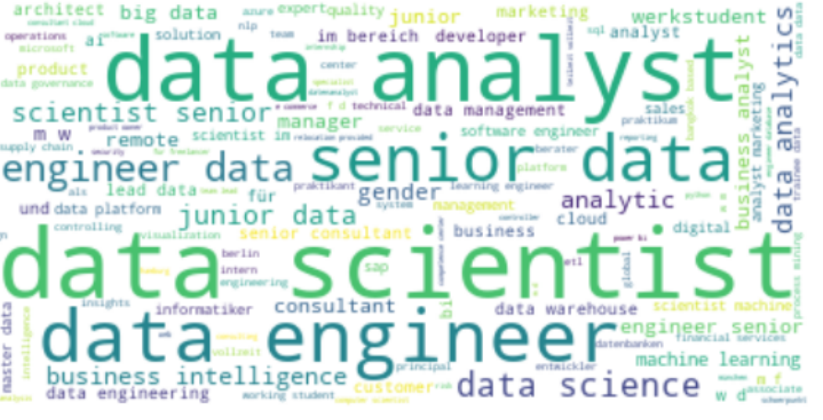



1. Web Scrapping
Keyword : Data scientist, Data Analyst, Data
Place : Germany

Slide 3
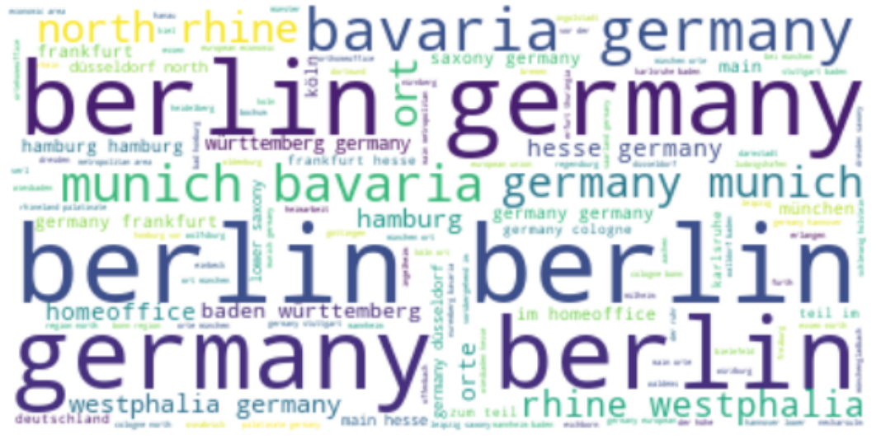
2. Exploratory Data Analyst
Language:
English: ~ 1400
Geman: ~ 2000
Location:
1. Berlin
2. Munich
3. Hamburg
4. Homeoffice
5. Frankfurt, Stuttgart, Düsseldorf

Slide 4
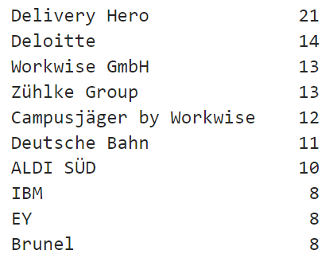
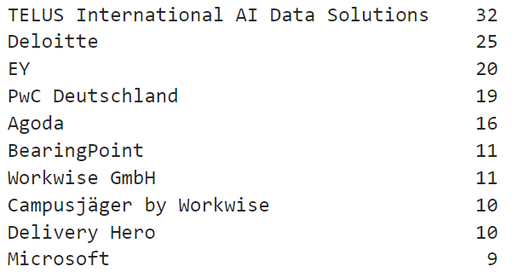
2. Exploratory Data Analyst
Company
Data scientist
Data analyst

Slide 5
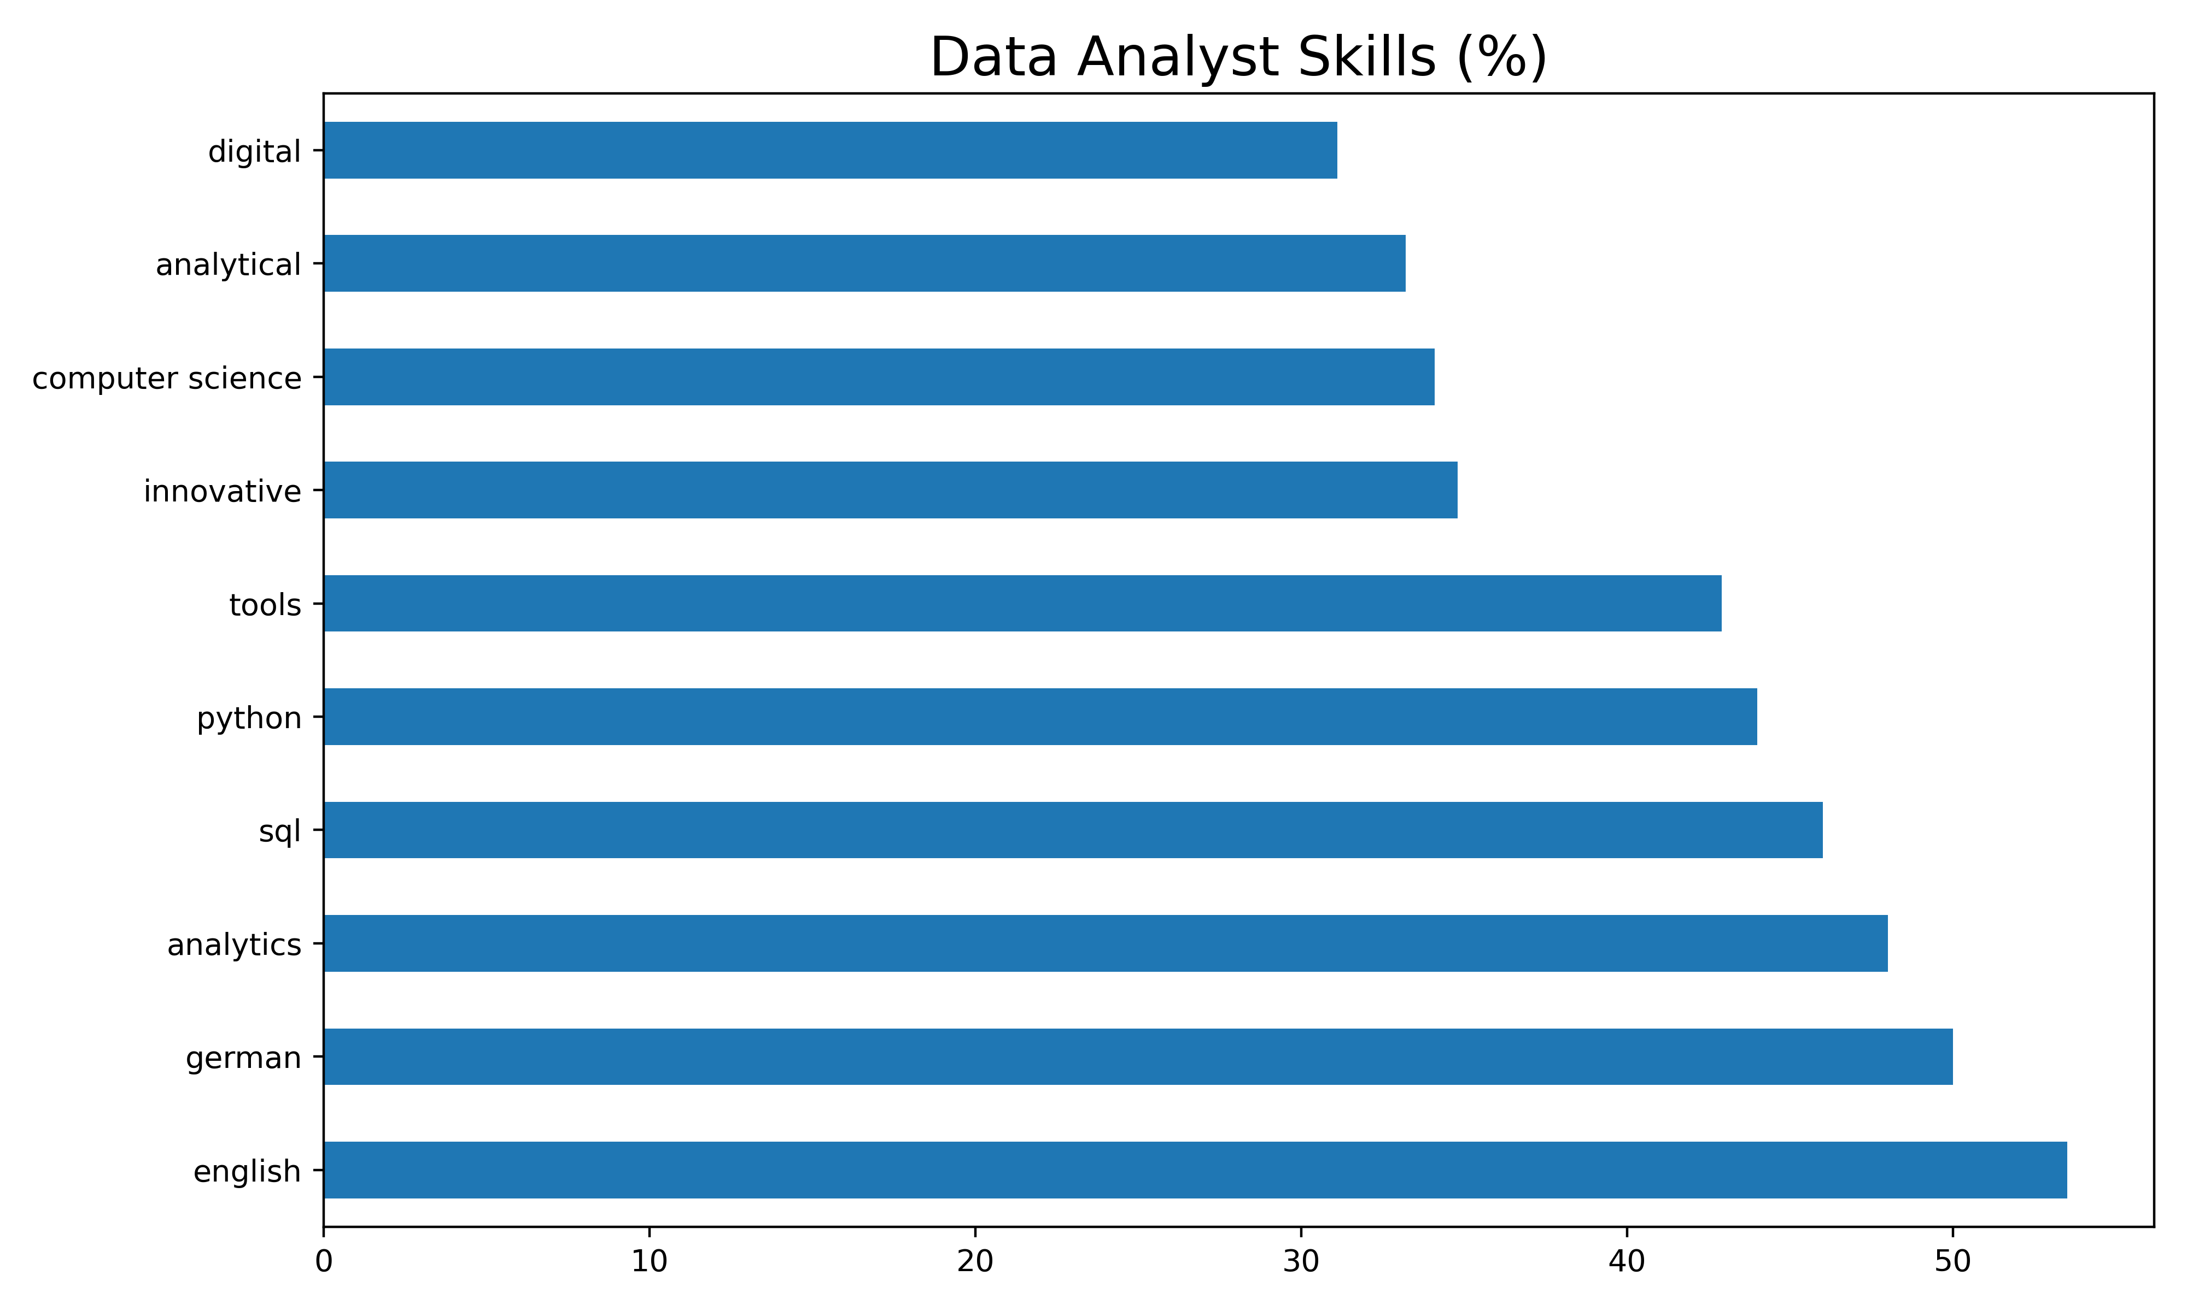
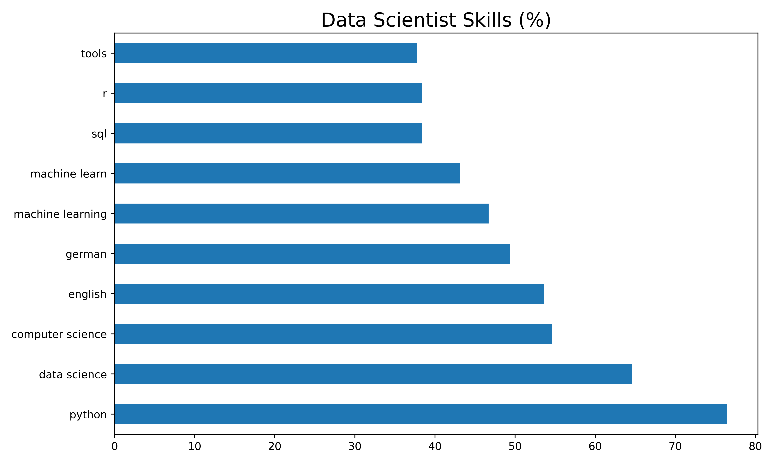
2. Exploratory Data Analyst

Slide 6

3. Job recommender
Using natural language processing (nltk, spacy)
Content Base recommender system
Cosin Similarity
Person correlation
KNN

